Slide 1
Digital HealthCare Space

Slide 2

Team Members
Prateek Jindal
Krithika S Udupa
Aryan Lala
Shriram Ghadge
Shubham Varade

Slide 3
Theme
Theme 4 :: Industry solutions on IBM Cloud (BFSI, Manufacturing, Health care, decentralize finance, Education, etc)
Healthcare - In times of Covid using software to bring about innovation in traditional healthcare is extremely important. E.g Improving medical and emergency communication, vaccination management and enforcement in public places, wearable technology, efficient provisioning of oxygen tanks, remote patient examination etc

Slide 4
Problem Statement
Personal health has always been an important part of one’s life, but it is only today that people have started becoming more health conscious. Despite of this, people are so busy with their lives that they don’t have the time nor want to take the efforts to look after their health

Slide 5
Our Proposition
We propose a solution to this problem by developing a one-stop healthcare app that would not only monitor a user’s health - related data, but also analyze that data in real-time to make predictions about some life-threatening problems like heart failures and warn them in advance

Slide 6
Use of IBM Cloud
IBM cloud is used as the brains for the complete system. Our AI, and backend, are running in IBM cloud Virtual server.
We are using the security and reliability provided by IBM cloud to make sure, client (user) data are stored safely and securely and only authorised access to data to support IBM BCG.
We are using a DB within IBM cloud virtual machine, but will explore better option provided with IBM cloud for final product.

Slide 7
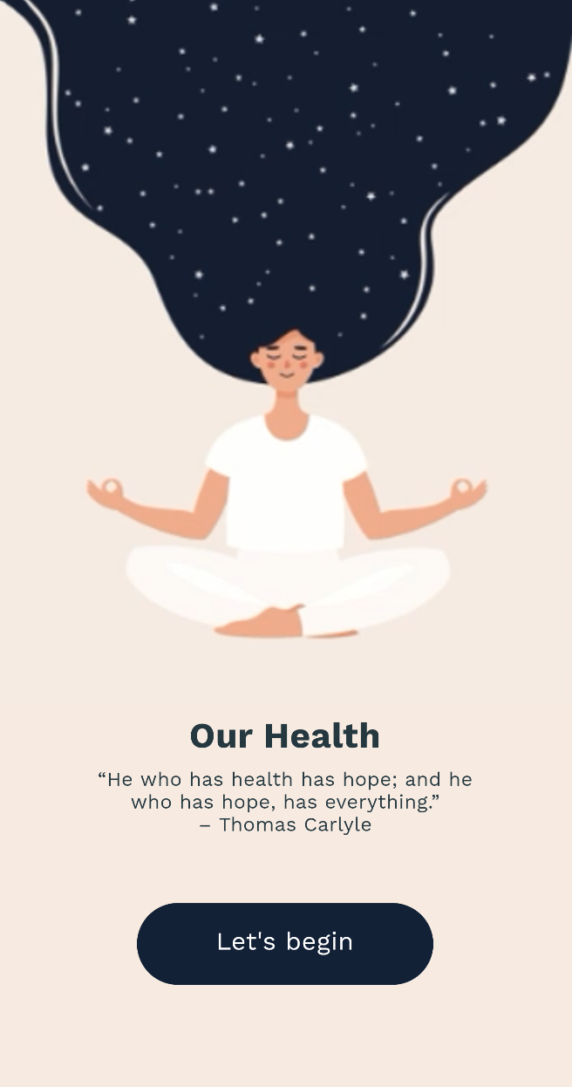
Solution design

Slide 8
Approach
Collecting Data
Collecting Basic Personal data like age, gender, weight, etc from user through mobile application
Created dummy service to replicate the functionality - collecting continuous data like body temperature, pulse rate, etc from IOT device (smartwatch)
Predicting the risk
Backend service based of machine learning model to predict the heart attack chances & alert on mobile application

Slide 9
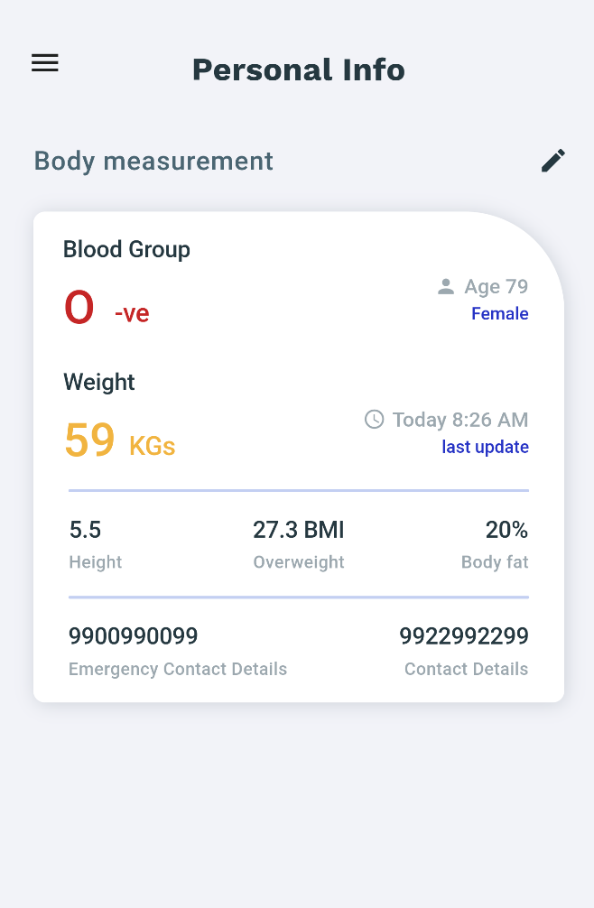
1
Personal details
View and maintain a profile about your personal details, diseases, medical files and more...

Slide 10
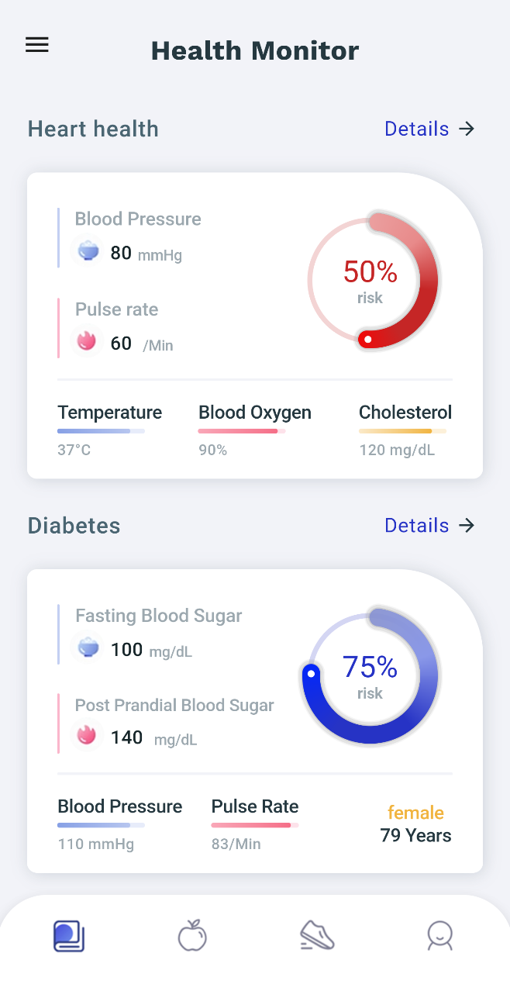
2
Health Monitoring
Monitor the health data collected from IoT devices and get summary of daily / weekly reports

Slide 11
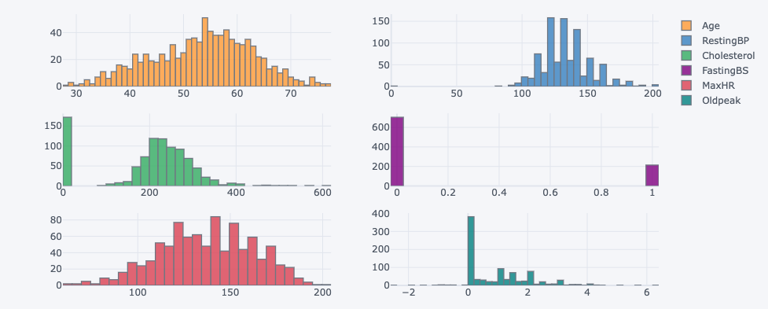
Histogram Plots of different features

Slide 12
Understanding the Data
Age: Age of the patient [years]
Sex: Sex of the patient [M: Male, F: Female]
ChestPainType: [TA: Typical Angina, ATA: Atypical Angina, NAP: Non-Anginal Pain, ASY: Asymptomatic]
RestingBP: Resting blood pressure [mm Hg]
Cholesterol: Serum cholesterol [mm/dl]
FastingBS: Fasting blood sugar [1: if FastingBS > 120 mg/dl, 0: otherwise]

Slide 13
Understanding the Data
RestingECG: Resting electrocardiogram results [Normal: Normal, ST: having ST-T wave abnormality, LVH: showing probable/definite left ventricular hypertrophy by Estes' criteria]
MaxHR: Maximum heart rate achieved [Numeric value between 60 and 202]
ExerciseAngina: Exercise-induced angina [Y: Yes, N: No]
Oldpeak: ST [Numeric value measured in depression] (
ST_Slope: The slope of the peak exercise ST segment [Up: upsloping, Flat: flat, Down: downsloping]
HeartDisease: Output class [1: heart disease, 0: Normal]
Reference: https://www.kaggle.com/fedesoriano/heart-failure-prediction

Slide 14
Extension
Extension to the application

Slide 15
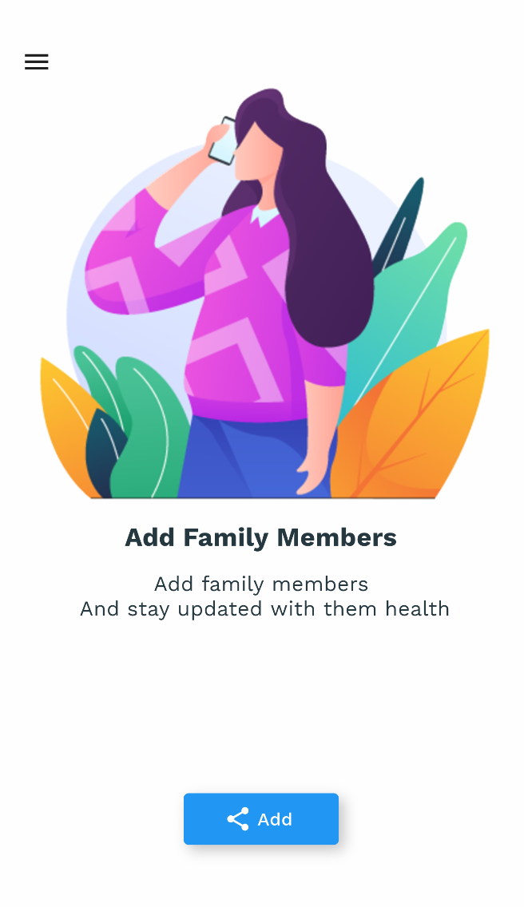
1
2
Health of Family
Add friends, family members to access your profile and daily activity, and revoke these permissions whenever needed
Emergency Alerts
Get warnings in advance if our model predicts chances of critical problems like heart attacks in your real-time data

Slide 16
3
4
5
Medication
Digital Reports
Reminders about medication & doctor visits (status update to family members)
Medical descriptions, x-rays, sonography reports can be provided digitally
IOT Monitoring during hospitalization
IOT based monitoring of patients during hospitalization. AI & ML models to assist the doctors for quick conclusions

Slide 17
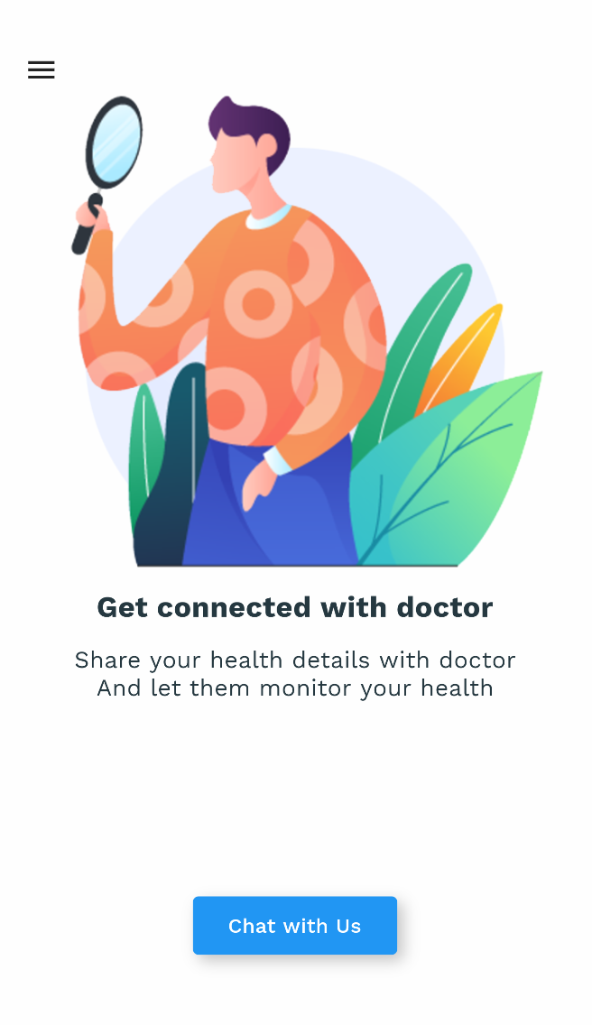
6
Online health monitoring & primary consultation by doctor
Online consultation by doctors by viewing profile and IoT data, for patients who are unable to go to them physically

Slide 18
Thank You

